Slide 1
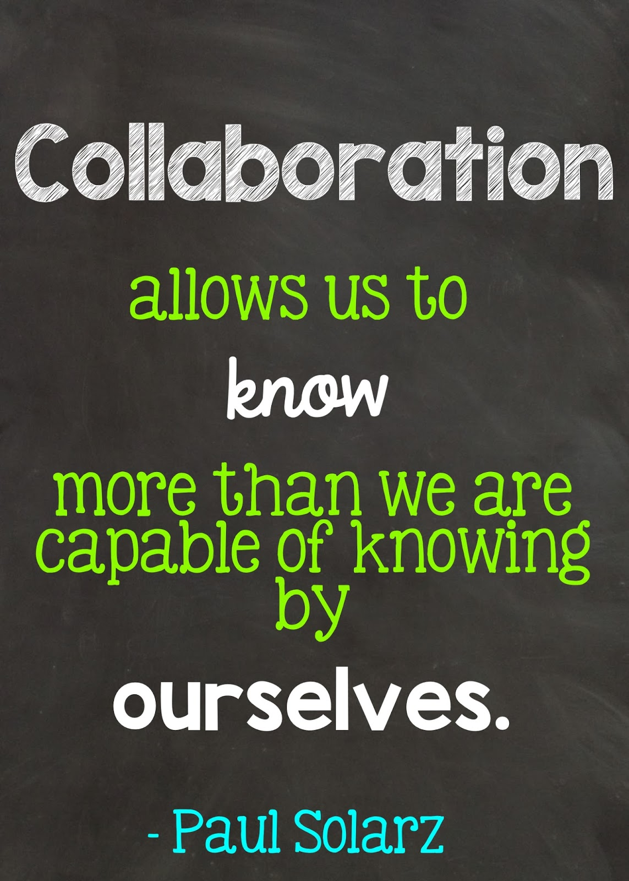
January - Collaboration
Grab a snack and PLEASE SIGN IN! We will be using technology the first half today, so please sign-in to your device. Thanks!

Slide 2
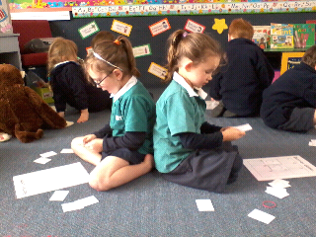
Warming Up with Barrier Games

Slide 3
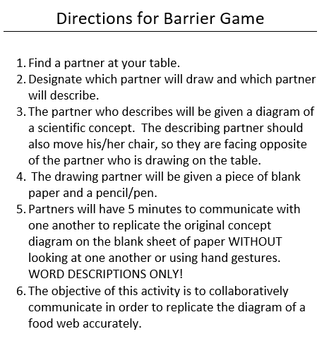

Slide 4
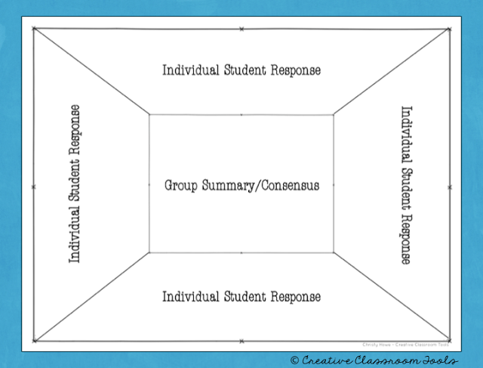
Consensus Placemat

Slide 5
Consensus Placemat digitized bit.ly/2DGF8Hs
To complete the placemat, the teacher poses a question about an important idea, concept, or skill. Each student then takes time to think independently about the question and write their response in their own space on the edge of the placemat.
When every member of the group is finished writing, the team shares ideas. You can use Round Robin to be sure that each student has an opportunity to share their ideas and hear the reasoning of their peers.
Once every idea has been shared, the team works together to create one answer with which every member agrees. The team then writes this consensus statement or summary in the center of the placemat.

Slide 6
Collaborative Annotation

Slide 7
Collaborative Review bit.ly/2FLr5RA
Create a review over concepts with the input of groups or each student in the class.
Assign each student/group the concept and then the class will build a review for each student to use.
Use a table to keep things organized. One Column should be the concept name. The other columns could be explanations, graphics, pictures, important vocabulary, videos, etc.
If technology is not available, you could create graphics and explanations to be put together on a review wall or poster.
We are going to build our own collaborative review with our favorite strategies. Go to bit.ly/collaborativereview to find the document.
EDIT IN THE BROWSER!
.

Slide 8
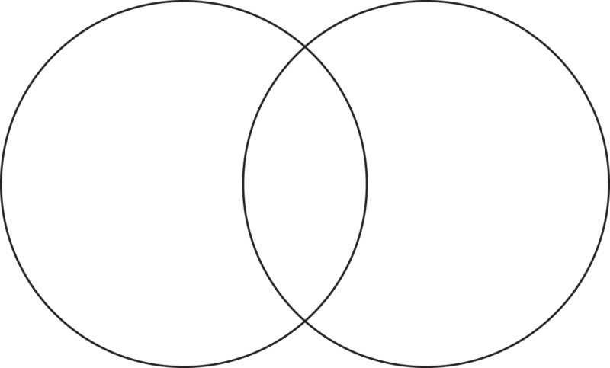
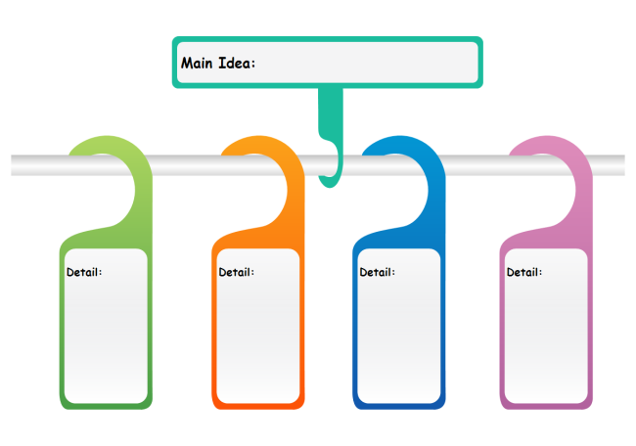
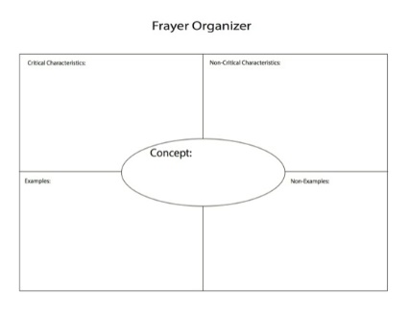
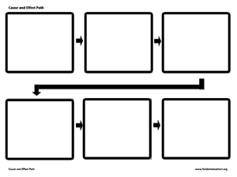
Carousel Graphic Organizers with a Twist!

Slide 9
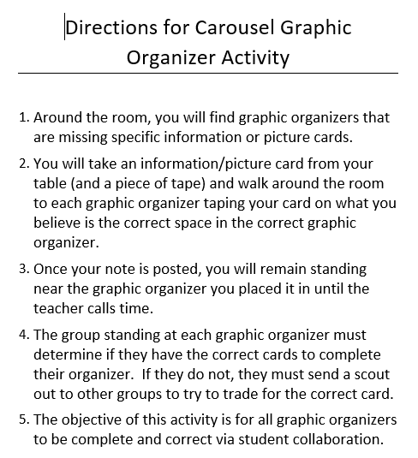

Slide 10
Pass the Story revised
Solar system
planet
rotation
axis
revolution

Slide 12
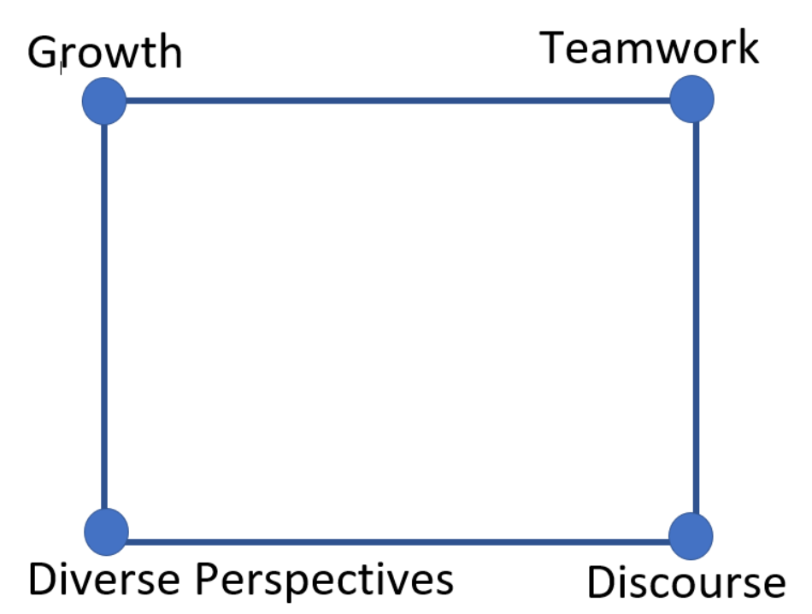
Connect the Dots to close our learning

